Slide 1
Kubernetes Intermediate
Training

Slide 2
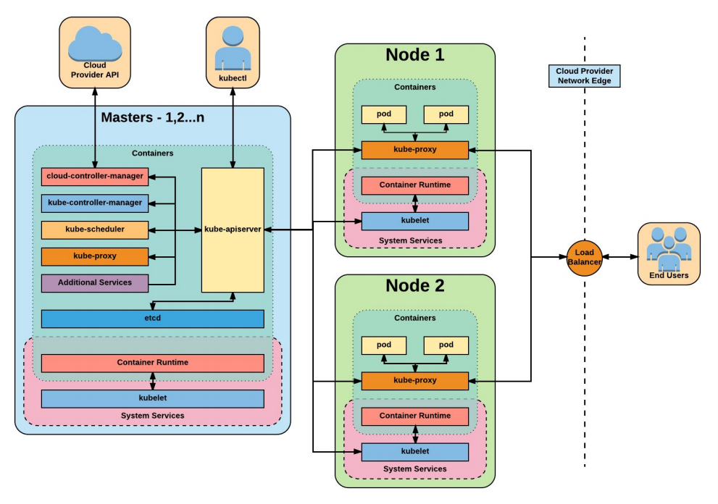

Slide 3
Kind
A Kubernetes "kind" cluster is a local Kubernetes cluster that runs inside Docker containers, using the tool kind (short for "Kubernetes IN Docker"). It is designed for testing and development purposes and allows users to create Kubernetes clusters without needing full-fledged cloud infrastructure or dedicated machines.
Kind is often used by developers to:
Test Kubernetes configurations and applications locally.
Develop Kubernetes operators, controllers, or CRDs (Custom Resource Definitions).
Run CI/CD pipelines for Kubernetes applications.

Slide 4
Kind
Since the clusters are containerized, they are lightweight, easy to spin up, and tear down.
You can simulate multi-node Kubernetes clusters by running multiple Docker containers that act as different nodes within the cluster.

Slide 5
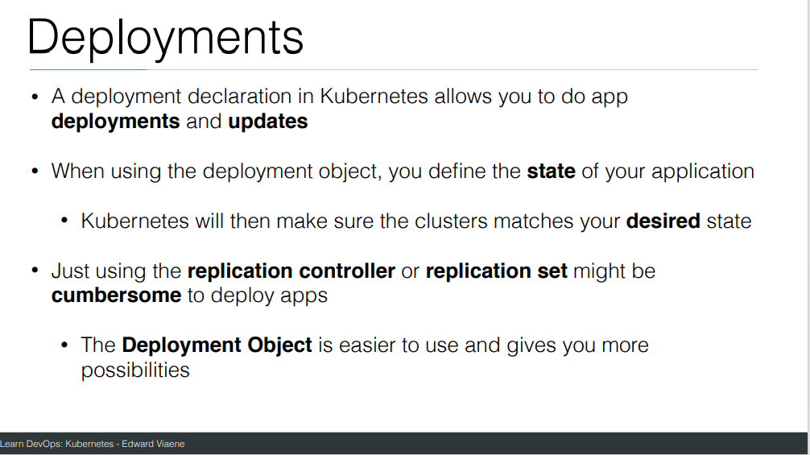

Slide 6
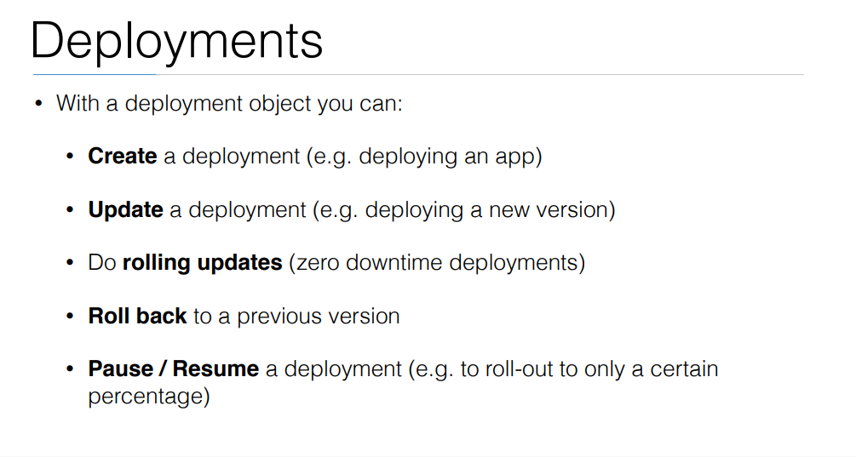

Slide 7
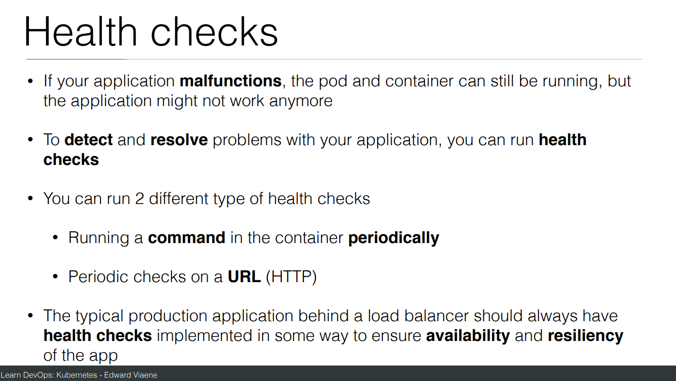

Slide 8
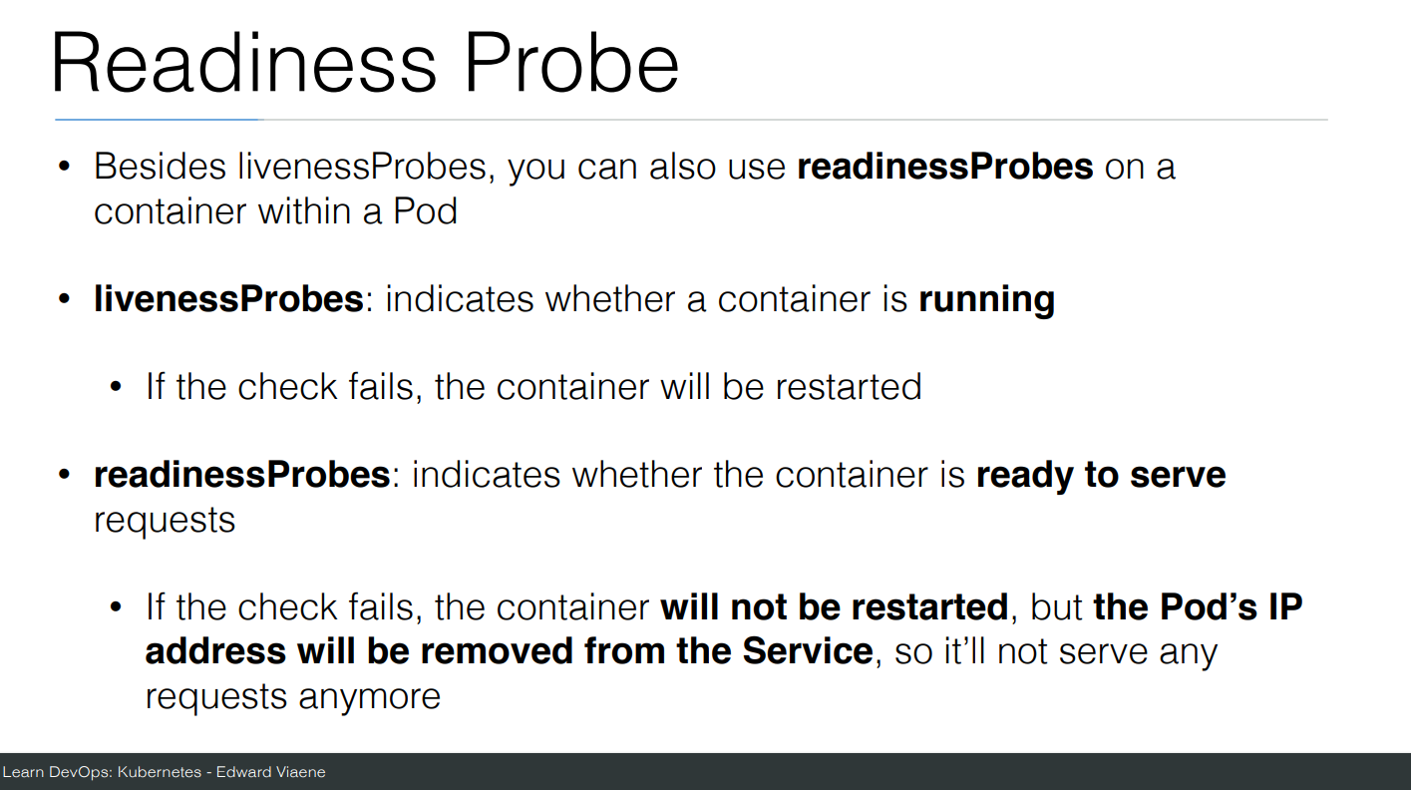

Slide 9
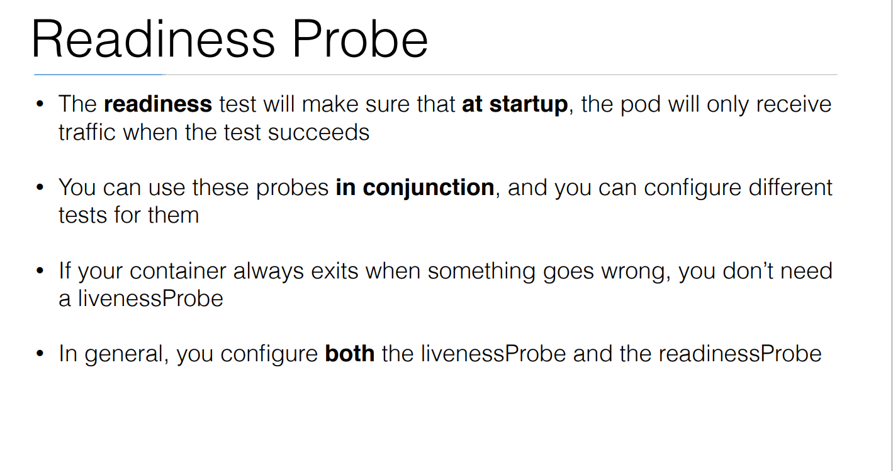

Slide 10
commands
Create a file called helloworld-deployment.yaml
Copy content from https://github.com/arjunachari12/k8s-learn/blob/main/helloworld-deployment.yml
kubectl create -f helloworld-deployment.yaml
kubectl get deployments
kubectl get rs
kubectl get pods
kubectl get pods --show-labels
kubectl rollout status deployment/helloworld-deployment

Slide 11
commands
Created new version of docker image and uploaded in docker hub
kubectl expose deployment helloworld-deployment --type=NodePort
kubectl get svc
minikube service helloworld-deployment --url
Curl url
kubectl set image deployment/helloworld-deployment k8s-demo=arjunachari12/k8s-demo:2
see
Curl to see new version

Slide 12
commands
kubectl get pods
kubectl rollout history deployment/helloworld-deployment
kubectl get pods
kubectl rollout undo deployment/helloworld-deployment
Curl again #modify history count
kubectl edit deployment/helloworld-deployment

Slide 13
Commands
Create a file helloworld-healthcheck.yml
kubectl create -f helloworld-healthcheck.yml
kubectl describe pod helloworld-deployment-7cfbb8fccf-78bxk
kubectl edit deployment/helloworld-deployment
#This will immediately run
kubectl create -f helloworld-healthcheck.yml && watch -n1 kubectl get pods

Slide 14
Commands
Create a file helloworld-liveness-readiness.yml
kubectl create -f helloworld-liveness-readiness.yml && watch -n1 kubectl get pods

Slide 15
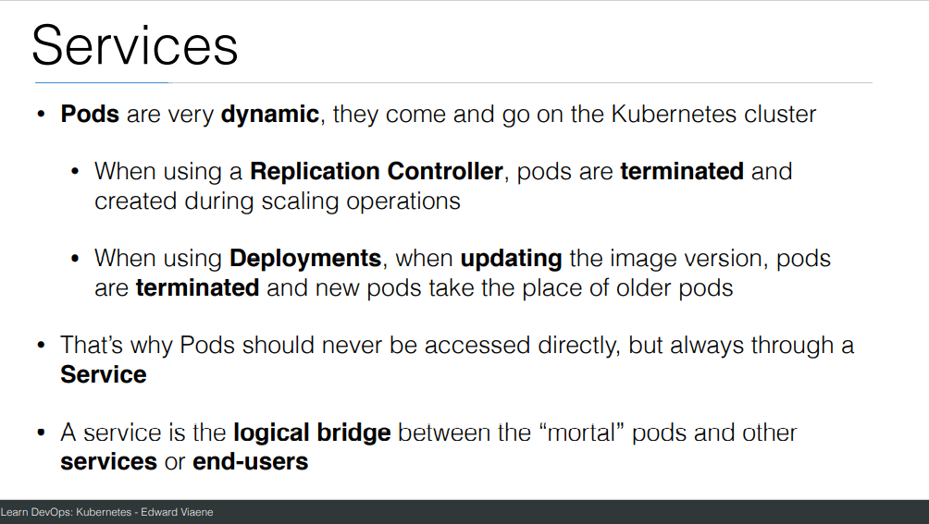

Slide 16
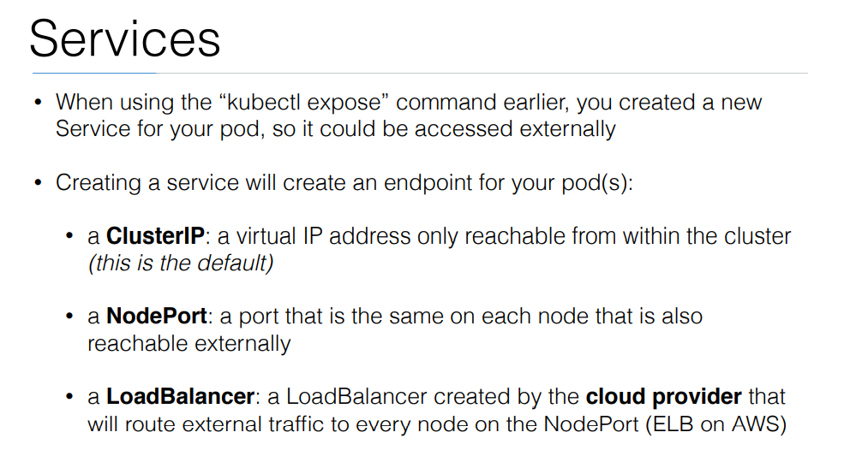

Slide 17
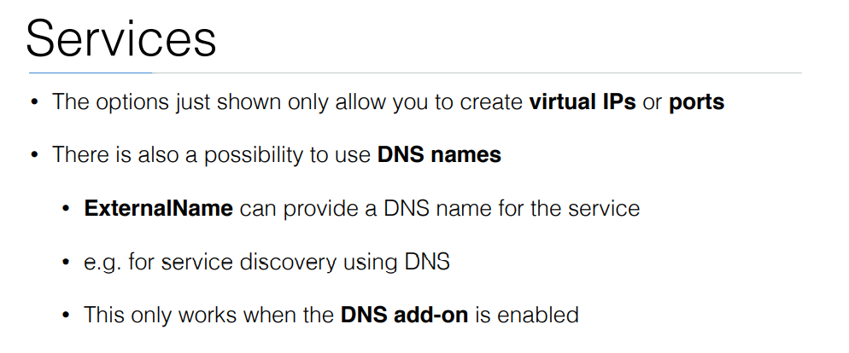

Slide 18
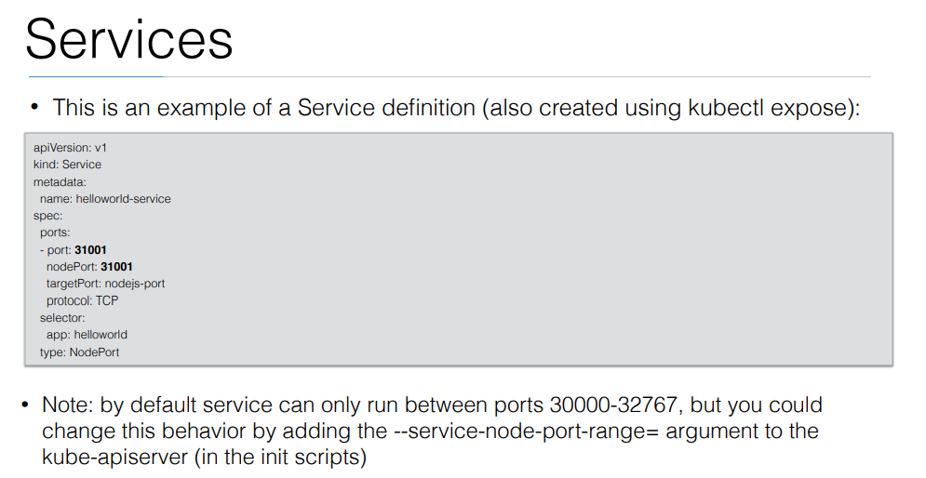

Slide 19
Exercise: Run image as pod
Hands-on steps:
Step 1: Open VS code and create new folder
Step 2 : write manifest file pod3.yml, copy code from below link
https://github.com/arjunachari12/k8s-learn/blob/main/pod3.yml
Step 3: Execute pod.yml file using below command
kubectl create -f pod3.yml
Step 4: You should see pod created message
Step 5: run below commands
kubectl get pod
kubeclt describe pod pod3

Slide 20
Exercise: Expose pod as Service
Hands-on steps:
Step 1: Open VS code and create new folder
Step 2 : write manifest file pod3-service.yml, copy code from below link
https://github.com/arjunachari12/k8s-learn/blob/main/pod3-service.yml
Step 3: Execute pod3-service.yml file using below command
kubectl create -f pod3-service.yml
Step 4: You should see pod created message

Slide 21
Exercise: Expose pod as Service
Hands-on steps:
Step 5: run below commands
kubectl get pod
kubeclt describe pod pod3
kubectl get svc
minikube service helloworld-service --url
kubectl describe svc helloworld-service
kubectl describe svc
Kubectl get svc
kubectl delete svc helloworld-nodeport-service.yml

Slide 22
Ingress
In Kubernetes, an Ingress is an API object that manages external access to services within a cluster, typically HTTP or HTTPS traffic.
It provides a way to expose your services to the outside world by routing traffic based on hostnames or paths to specific services running in the Kubernetes cluster.

Slide 23
Ingress
Ingress Controller:
This is a specialized load balancer responsible for fulfilling the Ingress rules. It watches the Kubernetes API for changes in Ingress objects and updates the routing configurations.
Common controllers include NGINX, Traefik, and HAProxy.
Ingress Resource:
This defines how traffic should be routed. You can specify rules that map requests (e.g., based on hostnames, paths) to corresponding services within the cluster.
Example: Traffic to myapp.example.com goes to the backend service myapp-service.

Slide 24
Features of Ingress
Path-based Routing: You can route traffic to different services based on URL paths.
Example: /api could be routed to one service, while /admin could be routed to another.
Host-based Routing: Ingress allows you to route based on the hostname (e.g., app1.example.com goes to one service, and app2.example.com to another).
TLS/SSL Termination: Ingress can handle SSL termination, which means it can handle HTTPS requests, often using certificates managed by Kubernetes secrets.
Load Balancing: Ingress provides a way to load balance traffic across multiple instances of your services.
Rewrite Rules and Headers: Some Ingress controllers support rewriting URL paths or adding/removing headers for requests.

Slide 25
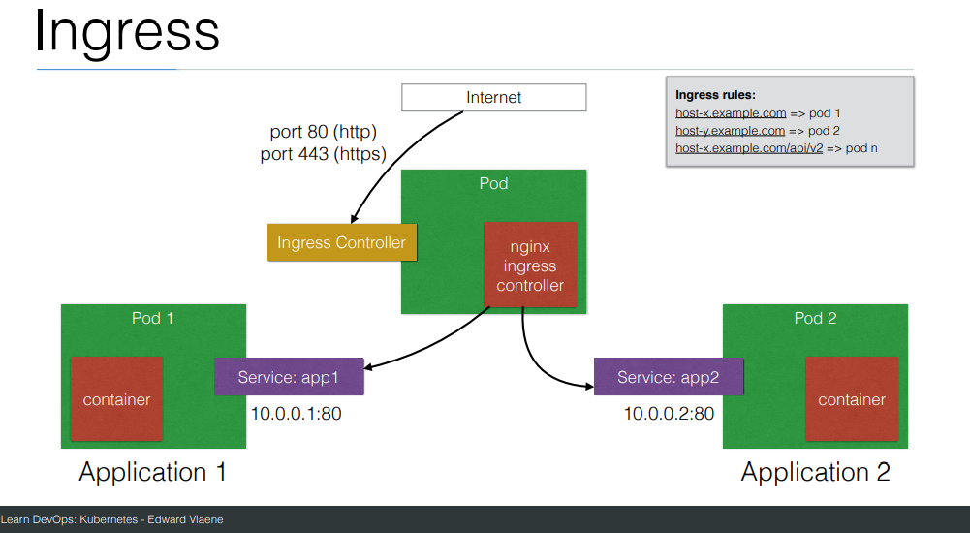

Slide 26
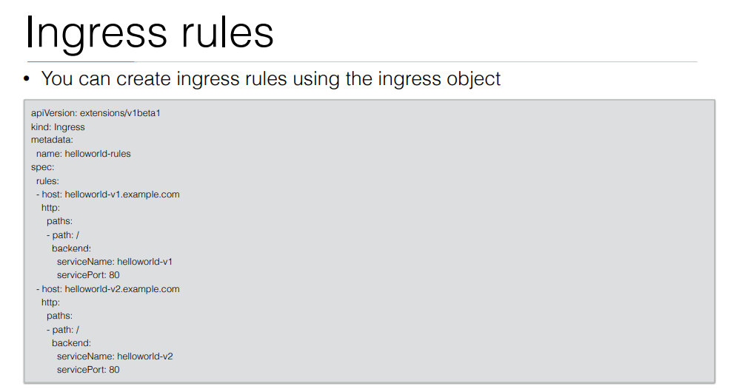

Slide 27
Pod scheduling
Pod scheduling in Kubernetes refers to the process by which the Kubernetes scheduler selects the most suitable node to run a pod.
This process ensures that the pod can function optimally while meeting any specific constraints or requirements.

Slide 28
pod scheduling process
1. Pod Requirements and Node Suitability
Before scheduling, Kubernetes evaluates each pod's requirements (resource needs, constraints, and any other scheduling rules) and matches them against the available nodes in the cluster. Some important factors include:
Resource requests: CPU, memory, and storage requirements.
Node affinity: Specific rules that determine whether a pod prefers or requires certain types of nodes (e.g., nodes with specific labels).
Taints and tolerations: Mechanisms to prevent pods from being scheduled on certain nodes unless the pod has a specific tolerance.
Pod affinity and anti-affinity: Rules that define whether a pod prefers or needs to be located near (or far from) other pods.
Node selectors: Conditions that filter nodes based on custom labels.

Slide 29
pod scheduling process
2. Filtering
Kubernetes first filters the nodes that can potentially run the pod. It excludes nodes that:
Don't have the necessary resources to satisfy the pod's resource requests.
Have taints that the pod doesn't tolerate.
Don't match the required labels (if nodeSelector or affinity rules are applied).

Slide 30
pod scheduling process
3. Scoring
Once Kubernetes identifies all nodes that meet the filtering criteria, it scores the nodes. Scoring helps the scheduler determine the best node based on factors such as:
Resource availability: Nodes with the most available resources might be preferred.
Pod distribution: The scheduler might aim to balance workloads across nodes to avoid hotspots.
Affinity rules: Nodes that match affinity preferences are scored higher.
Spread constraints: For example, distributing pods across zones or racks for availability purposes.

Slide 31
pod scheduling process
4. Binding
After scoring, Kubernetes selects the node with the highest score and binds the pod to that node. The pod is then scheduled to run on that specific node.
Common Features in Pod Scheduling:
Taints and Tolerations: Nodes can have "taints" that prevent pods from being scheduled on them unless those pods have corresponding "tolerations." This feature is often used to isolate certain nodes for specific workloads.
Affinity/Anti-affinity: You can define rules that control whether a pod is scheduled on the same node as another pod (affinity) or on different nodes (anti-affinity). This helps in spreading or grouping related workloads.
Preemption: When resources are scarce, higher-priority pods can preempt lower-priority pods, causing the lower-priority ones to be evicted to free up resources.

Slide 32
Node Affinity
Node affinity and anti-affinity are concepts in Kubernetes that control how pods are scheduled on nodes based on their labels. They allow you to express preferences or requirements for the nodes where your pods should run, enabling better management of workloads and resource utilization.
Node affinity allows you to constrain which nodes your pod can be scheduled on based on node labels. It is similar to the nodeSelector field but offers more flexibility and expressiveness.

Slide 33
Types of Node Affinity
RequiredDuringSchedulingIgnoredDuringExecution:
The scheduler must place the pod on a node that matches the specified labels. If no suitable node is found, the pod will not be scheduled.
This is a hard requirement.
PreferredDuringSchedulingIgnoredDuringExecution:
The scheduler will prefer to place the pod on nodes that match the specified labels, but it is not a hard requirement. If no preferred nodes are available, the pod may still be scheduled on other nodes.
This is a soft preference.

Slide 34
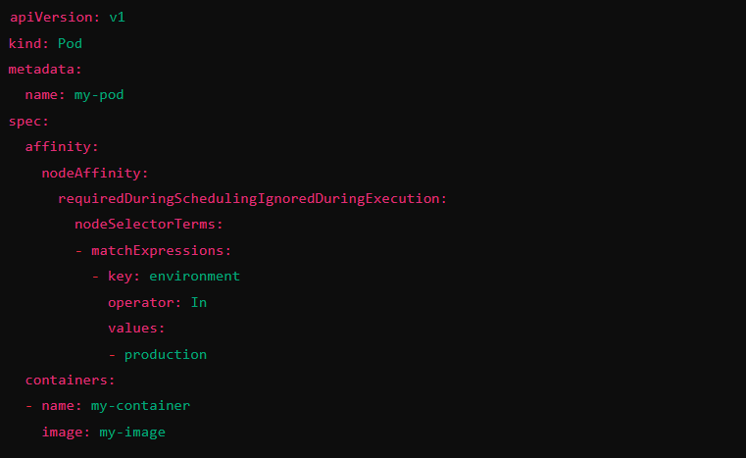
Types of Node Affinity

Slide 35
Node Anti-Affinity
Node anti-affinity is the opposite of node affinity. It allows you to specify rules that prevent a pod from being scheduled on certain nodes, typically based on labels of other pods running on those nodes. This can be useful for spreading workloads across nodes to improve availability and reduce the risk of single points of failure.

Slide 36
Types of Node Anti-Affinity
RequiredDuringSchedulingIgnoredDuringExecution:
The scheduler must not place the pod on a node that has certain labeled pods running on it. If it cannot find such a node, the pod will not be scheduled.
This is a hard requirement.
PreferredDuringSchedulingIgnoredDuringExecution:
The scheduler will prefer not to place the pod on nodes with specific labeled pods, but if no alternative nodes are available, the pod can still be scheduled on those nodes.
This is a soft preference.

Slide 37
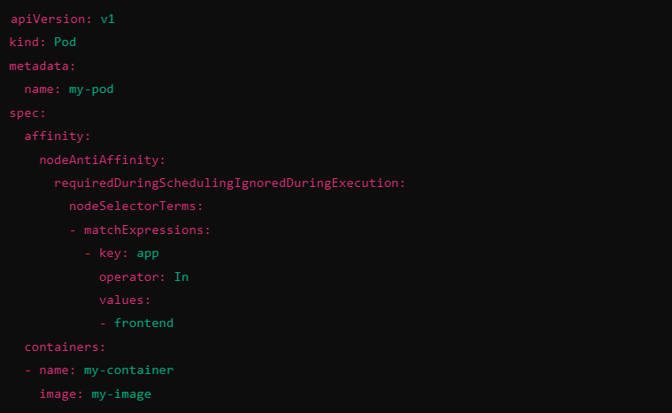
Types of Node Anti-Affinity

Slide 38
Node Affinity & Anti-Affinity
Node Affinity: Specifies where a pod should run based on node labels (can be hard or soft requirements).
Node Anti-Affinity: Specifies where a pod should not run based on the presence of certain labels on other pods (can also be hard or soft requirements).
Both node affinity and anti-affinity allow you to define more sophisticated scheduling behaviors, enhancing resource management, and increasing the reliability and resilience of your applications running on Kubernetes.

Slide 39
Exercise
# List nodes in the cluster
kubectl get nodes
# Label a node
kubectl label node <node-name> environment=production
kubectl label node ip-192-168-1-100.ec2.internal environment=production

Slide 40
Exercise: Apply Node Affinity to a Pod
apiVersion: v1
kind: Pod
metadata:
name: affinity-pod
spec:
affinity:
nodeAffinity:
requiredDuringSchedulingIgnoredDuringExecution:
nodeSelectorTerms:
- matchExpressions:
- key: environment
operator: In
values:
- production
containers:
- name: nginx
image: nginx

Slide 41
Exercise: Apply Node Anti-Affinity to a Pod
apiVersion: v1
kind: Pod
metadata:
name: anti-affinity-pod
spec:
affinity:
nodeAffinity:
requiredDuringSchedulingIgnoredDuringExecution:
nodeSelectorTerms:
- matchExpressions:
- key: environment
operator: NotIn
values:
- development
containers:
- name: nginx
image: nginx

Slide 42
Taint and Toleration
Taints and tolerations in Kubernetes are mechanisms used to control how pods are scheduled on nodes, allowing you to define rules that prevent or allow certain pods from being placed on specific nodes.
This feature ensures that workloads are placed appropriately based on node capabilities or other criteria.

Slide 43
Taints
A taint is applied to a node to mark it in a way that only pods with matching tolerations can be scheduled on it. Nodes with taints effectively repel pods unless those pods explicitly state they can tolerate the taint.
Taints are defined with three key elements:
Key: A label key that identifies the taint.
Value: A value for the taint.

Slide 44
Taints
Effect: The action Kubernetes should take when a pod does not tolerate the taint. There are three possible effects:
NoSchedule: Pods without a matching toleration will not be scheduled on the node.
PreferNoSchedule: Kubernetes will try to avoid scheduling pods on this node, but it's not a strict rule.
NoExecute: If a pod is already running on the node, it will be evicted unless it has a matching toleration.
kubectl taint nodes node1 dedicated=production:NoSchedule

Slide 45
Tolerations
A toleration is applied to a pod, indicating that the pod can "tolerate" a node’s taint. Tolerations allow the pod to bypass the restriction imposed by the taint and be scheduled on that node.
Tolerations are defined with:
Key: Matches the taint’s key.
Operator: Specifies how the pod matches the taint key. Common values are Equal (for equality matching) and Exists (only requires the key).
Value: Matches the taint's value.
Effect: Matches the taint's effect (either NoSchedule, PreferNoSchedule, or NoExecute).

Slide 46
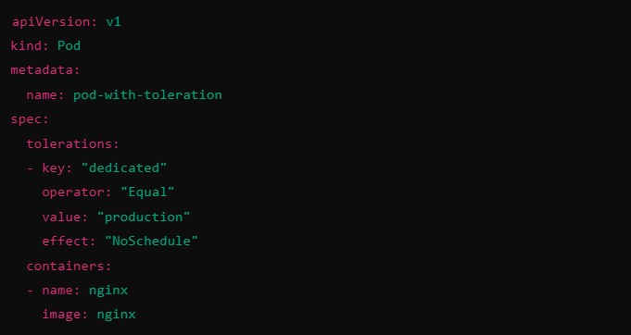
Tolerations

Slide 47
Use Cases & Summary
Dedicated workloads: Use taints to reserve specific nodes for certain workloads (e.g., production, testing).
Node isolation: Ensure that only certain workloads (e.g., high-memory workloads) run on nodes with specialized hardware.
Graceful node maintenance: Apply a NoExecute taint to evict all pods from a node in preparation for maintenance.
Taints are applied to nodes to restrict what pods can be scheduled there.
Tolerations are applied to pods, allowing them to be scheduled on nodes with specific taints.
This mechanism is key for controlling workload placement and managing nodes with specialized purposes or resource constraints.

Slide 48
Exercise
kubectl get nodes
kubectl taint nodes ip-192-168-1-100.ec2.internal dedicated=production:NoSchedule

Slide 49
Exercise: Create a Pod Without a Toleration (Will Not Be Scheduled)
Let's create a pod without a toleration. This pod will not be scheduled on the node tainted with dedicated=production.
apiVersion: v1
kind: Pod
metadata:
name: pod-without-toleration
spec:
containers:
- name: nginx
image: nginx

Slide 50
Exercise: Create a Pod With a Matching Toleration
Next, we’ll create a pod with a toleration that allows it to be scheduled on the node with the dedicated=production taint.
apiVersion: v1
kind: Pod
metadata:
name: pod-with-toleration
spec:
tolerations:
- key: "dedicated"
operator: "Equal"
value: "production"
effect: "NoSchedule"
containers:
- name: nginx
image: nginx

Slide 51
Helm
The package manager for Kubernetes
Helm is the best way to find, share, and use software built for Kubernetes.
Helm helps you manage Kubernetes applications — Helm Charts help you define, install, and upgrade even the most complex Kubernetes application.
Charts are easy to create, version, share, and publish — so start using Helm and stop the copy-and-paste.
Helm is a graduated project in the CNCF and is maintained by the Helm community.

Slide 52
Helm
Helm is a tool for managing Kubernetes packages called charts. Helm can do the following:
Create new charts from scratch
Package charts into chart archive (tgz) files
Interact with chart repositories where charts are stored
Install and uninstall charts into an existing Kubernetes cluster
Manage the release cycle of charts that have been installed with Helm

Slide 53
Helm
For Helm, there are three important concepts:
The chart is a bundle of information necessary to create an instance of a Kubernetes application.
The config contains configuration information that can be merged into a packaged chart to create a releasable object.
A release is a running instance of a chart, combined with a specific config.

Slide 54
Helm
Helm is an executable which is implemented into two distinct parts:
The Helm Client is a command-line client for end users. The client is responsible for the following:
Local chart development
Managing repositories
Managing releases
Interfacing with the Helm library
Sending charts to be installed
Requesting upgrading or uninstalling of existing releases

Slide 55
Helm
The Helm Library provides the logic for executing all Helm operations. It interfaces with the Kubernetes API server and provides the following capability:
Combining a chart and configuration to build a release
Installing charts into Kubernetes, and providing the subsequent release object
Upgrading and uninstalling charts by interacting with Kubernetes
The standalone Helm library encapsulates the Helm logic so that it can be leveraged by different clients.

Slide 56
Helm
The Helm client and library is written in the Go programming language.
The library uses the Kubernetes client library to communicate with Kubernetes. Currently, that library uses REST+JSON. It stores information in Secrets located inside of Kubernetes. It does not need its own database.
Configuration files are, when possible, written in YAML.

Slide 57
Helm Install
Prerequisites
The following prerequisites are required for a successful and properly secured use of Helm.
A Kubernetes cluster
Deciding what security configurations to apply to your installation, if any
Installing and configuring Helm.
Install guide
https://helm.sh/docs/intro/install/

Slide 58
Helm
A Chart is a Helm package. It contains all of the resource definitions necessary to run an application, tool, or service inside of a Kubernetes cluster. Think of it like the Kubernetes equivalent of a Homebrew formula, an Apt dpkg, or a Yum RPM file.
A Repository is the place where charts can be collected and shared. It's like Perl's CPAN archive or the Fedora Package Database, but for Kubernetes packages.
A Release is an instance of a chart running in a Kubernetes cluster. One chart can often be installed many times into the same cluster. And each time it is installed, a new release is created. Consider a MySQL chart. If you want two databases running in your cluster, you can install that chart twice. Each one will have its own release, which will in turn have its own release name.

Slide 59
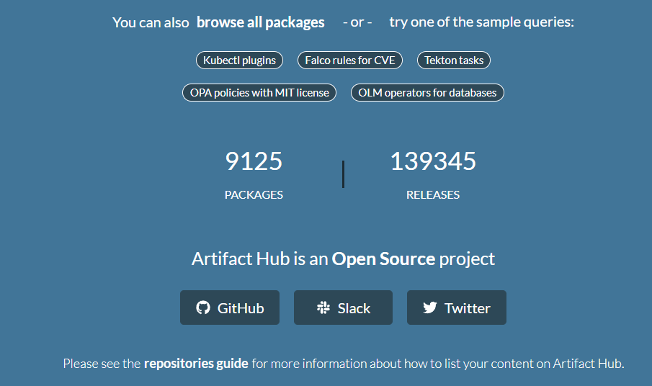
Helm Repo
https://artifacthub.io/

Slide 60
'helm search': Finding Charts
Helm comes with a powerful search command. It can be used to search two different types of source:
helm search hub searches the Artifact Hub, which lists helm charts from dozens of different repositories.
helm search repo searches the repositories that you have added to your local helm client (with helm repo add). This search is done over local data, and no public network connection is needed.

Slide 61
Commands
helm repo list
helm repo add bitnami https://charts.bitnami.com/bitnami
helm search repo bitnami
helm repo list
helm repo remove bitnami
helm repo add bitnami https://charts.bitnami.com/bitnami
helm search repo mysql
helm search repo database
helm search repo database --versions
#search from hub
helm search hub wordpresst

Slide 62
Commands
$add another repo
helm repo add brigade https://brigadecore.github.io/charts
#install with default name
helm install bitnami/mysql --generate-name
helm uninstall mysql-1612624192
helm status mysql-1612624192
helm install mydb bitnami/mysql
helm show values bitnami/mysql
kubectl get pods
helm list
helm istall mydb -n mynamespace
helm list --namespace mynamespace

Slide 63
Commands
helm uninstall mydb -n mynamespace
helm install happy-panda bitnami/wordpress
helm upgrade -f panda.yaml happy-panda bitnami/wordpress
#to have custom name
CHALLENGE
Run wordpress chart
to view chart
helm pull chartrepo/chartname
helm template nginx bitnami/nginx
helm install nginx bitnami/nginx --dry-run

Slide 64
Commands
helm get notes nginx
helm get values nginx
helm get values nginx --revision 2
helm get manifest nginx
helm history nginx
helm rollback nginx 2
helm uninstall nginx --keep-history

Slide 65
Create your own chart
helm create mychart
cd mychart
ls
cd ..
helm install release1 ./mychart
helm ls
kubectl get all
helm get manifest release1
rm -rf ./mychart

Slide 66
Create your own chart
helm create mychart
rm -rf mychart/templates/*
cd mychart/templates
#create a new file called configmap.yaml
code configmap.yaml
#add below content
apiVersion: v1
kind: ConfigMap
metadata:
name: {{ .Release.Name }}-configmap
data:
myvalue: "Sample Config Map"

Slide 67
Create your own chart
cd ..
cd ..
helm install release-configmap ./mychart
helm ls
helm get manifest release-configmap
kubectl describe configmaps mychart-configmap
helm uninstall release-configmap

Slide 68
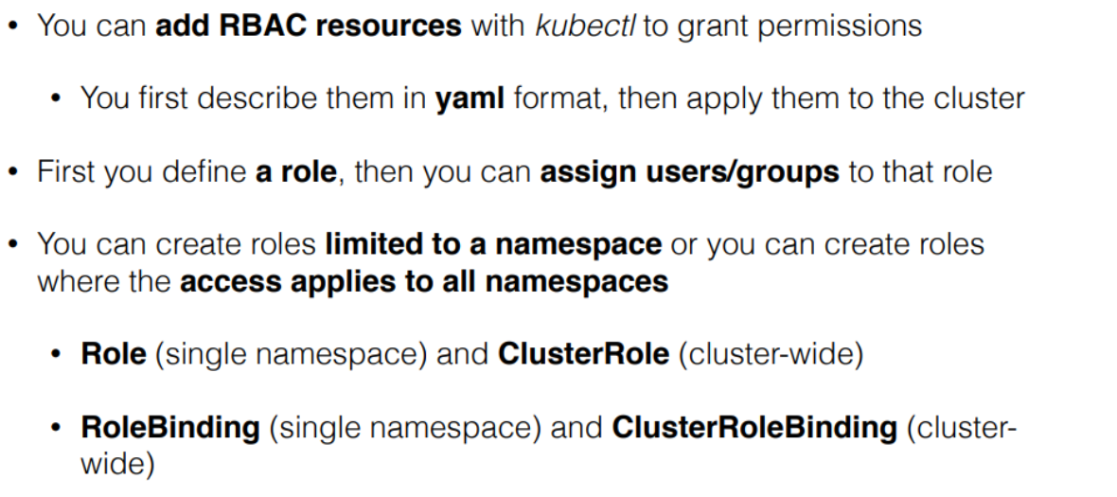
RBAC

Slide 69
